Slide 1

CloudMaven DevOps Assessment Project
Name: Imran Nadaf Role: DevOps Intern Duration: 3 Months Technologies: Terraform, AKS, Docker, Kubernetes, Grafana, Azure, CI/CD

Slide 2








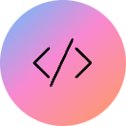



Project Overview
Azure DevOps Environment
2-Tier Microservice Application
Built a production-ready, scalable DevOps environment entirely on Microsoft Azure, leveraging its robust cloud services.
Deployed a modular 2-tier microservice application consisting of a distinct frontend and backend for enhanced scalability and maintainability.
Full CI/CD Pipeline
Robust Observability
Implemented a comprehensive Continuous Integration/Continuous Deployment pipeline using GitHub Actions, ensuring automated and efficient code delivery.
Integrated Prometheus and Grafana for real-time monitoring.
Infrastructure as Code (IaC)
AKS Deployment with NGINX
Managed all infrastructure provisioning and configuration using Terraform, ensuring consistency, repeatability, and version control for the entire environment.
Deployed the application on Azure Kubernetes Service (AKS) with NGINX Ingress for efficient traffic management and service exposure.

Slide 3
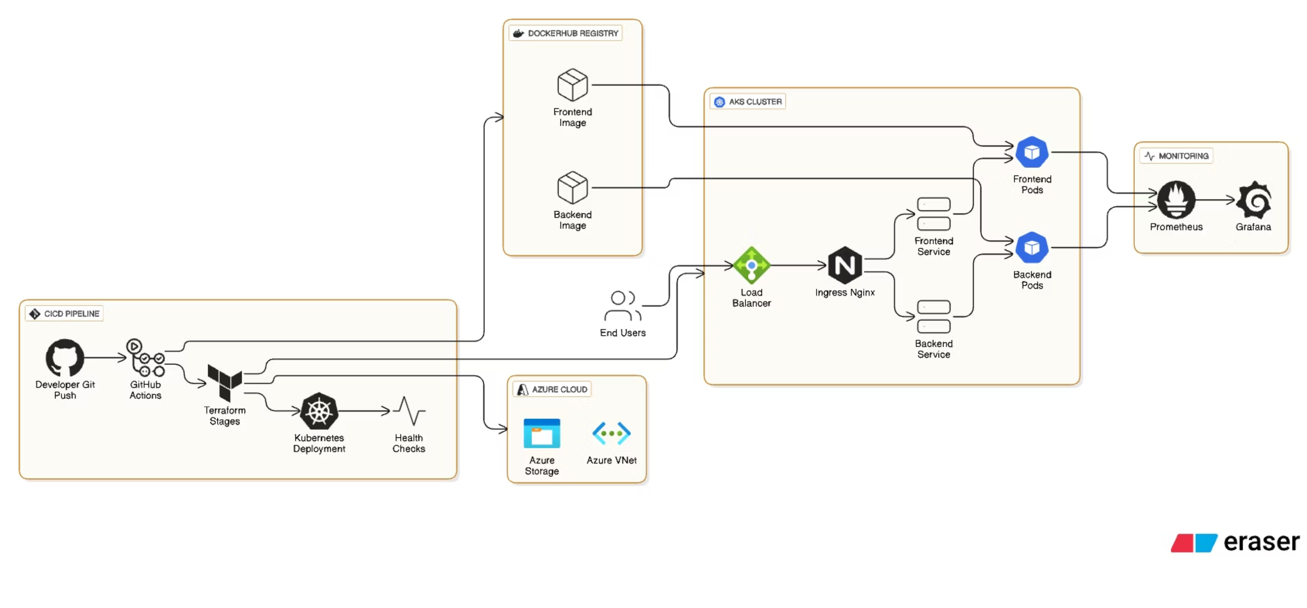
Architecture Diagram

Slide 4
Core Technologies: Our DevOps Toolset
Cloud Platform: Azure
Infrastructure as Code: Terraform
Leveraged Azure for scalable, reliable cloud infrastructure and managed services.
Defined and provisioned all cloud resources efficiently and consistently.
Containerization: Docker
Orchestration: AKS & Kubernetes
Packaged applications and dependencies into portable containers for consistent deployment.
Managed containerized applications at scale with Azure Kubernetes Service, including Deployments, Services, and Ingress.
CI/CD Automation: GitHub Actions
Monitoring: Prometheus & Grafana
Automated build, test, and deployment workflows directly from our GitHub repository.
Provided real-time visibility into application and infrastructure performance.
Development: Python (Flask) & Nginx
The application backend was developed with Python Flask, served efficiently by Nginx.

Slide 5






CI/CD Pipeline: Automating Our Workflow
Our Continuous Integration/Continuous Deployment pipeline ensures rapid, reliable, and automated delivery of software changes.
Developer Pushes to GitHub
Code changes are committed and pushed to the main repository, triggering the CI/CD workflow.
Continuous Integration (CI)
Automated steps for validation: Terraform validation, Docker image build and testing, Kubernetes linting for manifest correctness.
Continuous Deployment (CD)
Terraform plan execution for infrastructure changes, Docker image build and push to Azure Container Registry, and deployment to AKS.
Rollout Verification
Automated checks ensure successful deployment and service availability post-update.
Smoke Testing (/api/health)
Essential API endpoints are checked for basic functionality and responsiveness.
Post-Deployment Monitoring
Continuous monitoring begins, providing immediate feedback on application health and performance.

Slide 6
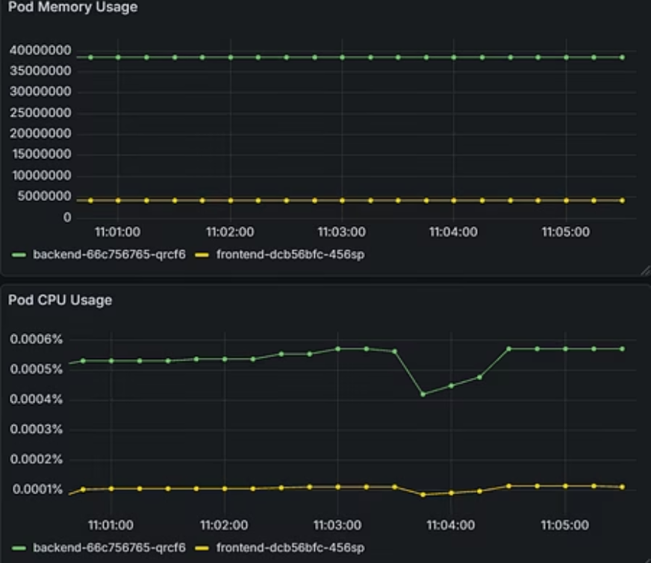
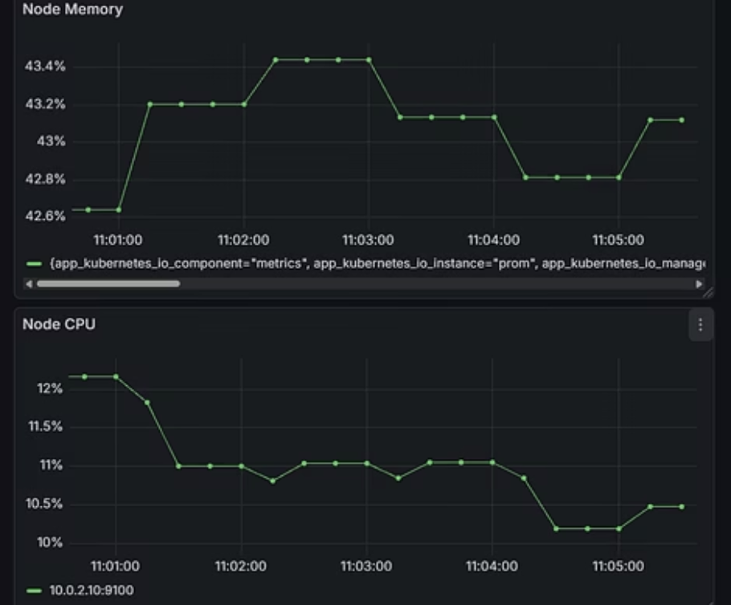
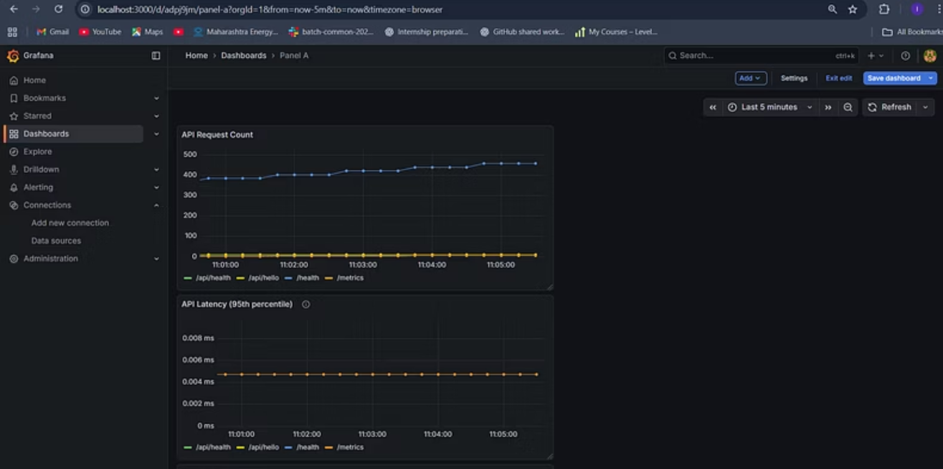
Real-time Insights with Grafana Dashboards
Grafana dashboards provide a comprehensive overview of our application and infrastructure health, enabling proactive issue detection.
These visualizations are crucial for maintaining performance

Slide 7
Key Learnings: Growth Through Hands-On Experience
1
Terraform Provisioning
Mastered Infrastructure as Code principles by provisioning and managing Azure resources with Terraform.
2
AKS Cluster Management
Gained expertise in setting up, configuring, and managing Azure Kubernetes Service, including networking and ingress controllers.
3
CI/CD Automation
Developed robust CI/CD pipelines using GitHub Actions for automated build, test, and deployment.
4
Containerization & Images
Deepened understanding of Docker for containerizing applications and managing container images efficiently.
5
Monitoring & Observability
Implemented comprehensive monitoring solutions with Prometheus and Grafana, providing critical insights into system health.
6
Kubernetes Debugging
Honed problem-solving skills by debugging complex Kubernetes issues, ensuring application stability.
7
Cloud-Native Tooling
Gained end-to-end experience working with a diverse stack of modern cloud-native tools.

Slide 8

Challenges Faced: Overcoming Technical Hurdles
Throughout the project, I encountered and successfully resolved several technical challenges, reinforcing my problem-solving abilities and deepening my understanding of DevOps complexities.
1
2
3
ImagePullBackOff Issues
Ingress Routing Mismatch
ServiceMonitor CRD Missing
Diagnosed and resolved issues related to container image pulling failures in Kubernetes.
Troubleshot and corrected NGINX Ingress rules to correctly route traffic to backend services, particularly for the /api path.
Addressed issues where custom resource definitions for ServiceMonitor were not correctly applied, impacting Prometheus scraping.
4
5
6
AKS CIDR Overlap
Grafana Metric Alignment
Storage Backend Permissions
Resolved network configuration conflicts arising from CIDR overlaps in the AKS virtual network.
Ensured accurate data visualization by correctly aligning metrics and queries within Grafana dashboards.
Configured correct permissions for storage backends, crucial for data persistence in stateful applications.
7
Elasticsearch Resource Errors
Optimized resource allocation to prevent out-of-resource errors for Elasticsearch deployments, ensuring stable logging.

Slide 9

Thank You for Your Time and Consideration!
I am enthusiastic about the opportunity to contribute my skills and learnings to your team.

